Slide 1
MiFID II/MiFIR – Transparency & Best Execution requirements in respect of bonds
27 April 2016
Vienna
Elizabeth Callaghan

Slide 2
Overview
Key objectives of MiFID II/R & transparency requirements for bonds
Timeline
The new market structure paradigm
Market structure – today & tomorrow
Draft transparency requirements:
  Pre-trade
  Post-trade (including who reports)
  Best execution
Market concerns
Conclusion
Annex:
  Draft liquidity assessment
  Draft waivers and deferrals
  Systematic internalisers

Slide 3
Key objectives of MiFID II/R and the transparency requirements
Move OTC trading onto trading venues through a trading obligation for non-equites. E.g. Organized Trading Facility (OTF). Systematic Internalisers will also become more relevant for bond trading.
Increase transparency and create a price discovery mechanism, by expanding pre- and post-trade transparency requirements to non-equity instruments.
Preserve liquidity in already challenged markets:
pre-trade waivers and post-trade deferrals
tailored approach to calibration of transparency requirements for different types of trading systems
Increase available data (so that market participants are informed as to the true level of potential transactions)

Slide 4
MiFID II/R timeline
2015-16
2017?
2018?
Q3: ESMA final technical standards
Q3 2015/ Q1 2016: implementing measures finalized
Q1: MiFID II/R originally scheduled to take effect
Q1: Expected date for MiFID II/R to take effect

Slide 5
The new market structure paradigm
Venue / Multilateral Trading
Bilateral Trading
Regulated Market
Multilateral Trading Facility
Organised Trading Facility*
Systematic Internaliser*
Over-the-Counter
Exchange
MTF
OTF
non-equities only
SI
OTC
e.g. Euronext, EuroMOT, BondVision,
Stock Exchanges
e.g. BTEC, iSwap, Tradeweb, MarketAxess
Bloomberg (soon),
e.g. IDBs like GFI
Broker crossing networks with discretionary order matching.
e.g. active market makers, maybe active Funds
Trade own capital
Test per instrument: Systematic,
Frequent & Substantial;
Can opt in
The rest
*New
Goal: encourage more venue trading
Market Structure forms basis for transparency obligations
Level of transparency applied depends on 3 characteristics:
  Liquid
  Size Specific To the Instrument (SSTI) / “small” size
  Large in Scale (LIS) / “block” size
MiFID II Level 1
Liquid continuous buying & selling interest
SSTI no undue risk to liquidity providers
LIS large in scale vs normal market size

Slide 6
Market Structure – Where we are now and where we may be in the future:
Liquidity test as we understand it today:
 | Products Eligible for Liquidity Tests (volumes all euros) |  | Liquidity Test (Floors) | Liquidity Test Level | Calculation Frequency: Liquidity Test & Thresholds
Bonds | Sovereigns | 1bn+ | 2 trades & 100k on 80% of days (no Liq test for new issues) | By ISIN (IBIA) & By Class (COFIA) for new issues | Quarter
 | Corporates Covereds Convertibles | 0.5bn+
Liquidity test tomorrow*:
 | Year 1 (2018) | Year 2 (2019) | Year 3 (2020) | Year 4 (2021)
Liquidity Test: | 15 trades per/day | 10 trades per/day | 7 trades per/day | 2 trades per/day
*(subject to EU approval)
SI test tomorrow*:
SI in 1 bond, requirement is to be an SI for that issuer for all new issues, regardless of currency.
*(subject to EU approval)

Slide 7
Pre – trade - draft transparency requirements:
Applies to RMs, MTFs, OTFs and SIs
Operators must make publicly available, on a continuous basis during trading hours, actionable indications of interest (IOIs); i.e. current bid and offer prices, and depth of trading interest .
  Including:
  Request For Quote (RFQ) systems and voice trading systems
  SIs, where they make quotes public, will trade at quote w/all clients of SI, subject to commercial policy (E.g. transparency limits and size thresholds.)
Waivers:
  Pre-trade transparency requirements can be waived for:
        Financial instruments for which there is not a liquid market
        Orders that are large in scale (LIS) compared to normal market size
        Orders on RFQ or voice trading systems that are equal to or larger that the relevant size specific to the instrument (SSTI)
        Orders held in an order management system

Slide 8
Pre-trade - transparency
Trading venue
Liquidity
Trade size
Trade
Liquid?
< SSTI
(for RFQ)
or LIS (on O.B.)?
Transparent
RM, MTF, OTF?
Yes
Yes
Yes
OTC (SI)?
Yes
Liquid?
Yes
< SSTI?
Yes
OTC
(non-SI)?
No
No
No
No pre-trade transparency

Slide 9
Post-trade – Draft transparency requirements
Applies to RMs, MTFs, OTFs, and investment firms trading OTC.
Investment firms trading outside a trading venue and market operators and investment firms operating a trading venue, must make publicly available trade details, including price and quantity.
Post-trade information must be available as close to real time as possible (15 minutes from execution, up until Jan 2020 and within 5 minutes thereafter).
There are no permanent waivers for post-trade reporting, but reporting can be deferred for up to 48 hours in the case where:
        The transaction is in a security for which there is not a liquid market
        The size of the transaction is equal to or exceeds the relevant large is scale size (LIS)
Under certain circumstances, a supplementary deferral regime grants relevant NCAs the authority to aggregate the trade details of several transactions, or omit publishing the size of an individual transaction, for an extended deferral period of up to 4 weeks.
Where a class of instrument suffers a significant reduction in liquidity, the relevant NCA can temporarily suspend transparency requirements for that class (for up to 3 months). E.g. Greece.

Slide 10
Who reports post-trade publically?
If executing on a venue – Venue reports
  E.g. Bloomberg
If executing with an SI – SI reports
  E.g. Goldman Sachs
If executing via OTC – OTC “Seller” reports
  “Seller” investment firm E.g. Axa, Citi

Slide 11
Post – trade - Draft transparency requirements
Trading venue
Liquidity
Trade size
Trade
REAL-TIME
RM, MTF, OTF?
Yes
Liquid?
Yes
< SSTI
or
LIS?
Yes
No
No
Investment Firm, incl. SI?
Yes
Liquid?
Yes
< SSTI
or
LIS?
Yes
No
No
DEFERRED
(2 days or up to 4 weeks with NCA approval)

Slide 12
Best Execution – RTS 27
Draft transparency requirements: best execution – reporting criteria
Provide the public with relevant data on execution quality to help them determine the best way to execute client orders.
Execution venues including regulated markets, MTFs, SIs, OTFs, market maker or other liquidity providers must publish.
In order to provide a proper context for the quality of execution obtained, the amount and nature of reported data will be segregated according to trading systems, trading modes and trading platforms.
Execution venues shall publish required information in a machine-readable electronic format on a quarterly basis, available for downloading by the public. (see Annex for details)

Slide 13
Best Execution – RTS 28
Draft transparency requirements: best execution – quality of execution – Top 5 venues
Investment firms will evaluate the quality of their execution practices by identifying and publishing the top 5 execution venues, in terms of trading volumes where those firms executed client orders in the preceding year.
This will be for each class of financial instrument and will be expressed in percentages (% of investment firm’s total execution volumes and number of executed orders in that class of financial instrument, rather than absolute values).
Information published will be split between retail client flow and professional client flow.
In a separate report, investment firms will summarise and make public the top 5 execution venues where they executed securities financing transactions (including repos).
Investment firms will clearly indicate the classes of financial instruments for which they execute a very small number of orders.
Investment firms shall publish for each class of financial instruments, a summary of the analysis & conclusions based on the quality of execution on the execution venues.

Slide 14
MiFID II – Wrap-up thoughts
Opportunities | Improved information Increased automation through: | On real liquidity through post-trade info Reduces time on price discovery Increased venue trading Best execution requirements OMS/EMS functionality Helping to facilitate “sourcing liquidity” APAs, Automating voice, OMS upgrades, Best X requirements and TCA
Key Market Concerns | 48 Hr deferral: Higher Costs: Inconsistency Data | Not considered enough time to hedge or trade out of an illiquid or large trade. Market-makers are exposed to unwarranted market risk. A disincentive to market- makers. Technology builds Application of deferrals across jurisdictions, depending on counterparty’s location, could impact liquidity and pricing Quality/reliability – reporting & challenges with the costs of consolidating data
Still waiting on… ? | Package Transactions Final RTS | Pre-trade treatment (same as post) Could be as late as autumn, no extra time to build!

Slide 15
Next steps for MiFID II:
ESMA & Commission working hard to address implementation challenges
IOSCO creates Symbology Working group: to determine “Unique Identifiers”
Industry wide ICMA initiatives helping with strategy, planning and implementation:
        MiFID II Working Group
        Electronic Trading Working Group (ETWG): Buy-side & Sell-side consensus led working group tackling the challenges of MiFID II
        Platform Working Group (PWG): Platform only based working group interacting with each other to discuss MiFID II, the challenges and again through consensus come up with solutions for best practice

Slide 16
Contact details:
ICMA Secondary Markets contacts
Elizabeth Callaghan
liz.callaghan@icmagroup.org +44(0)20 7213 0313
Andy Hill
andy.hill@icmagroup.org +44(0)20 7213 0335
Alexander Westphal
alexander.westphal@icmagroup.org +44(0)20 7213 0333
This presentation is provided for information purposes only and should not be relied upon as legal, financial, or other professional advice. While the information contained herein is taken from sources believed to be reliable, ICMA does not represent or warrant that it is accurate or complete and neither ICMA nor its employees shall have any liability arising from or relating to the use of this publication or its contents.
© International Capital Market Association (ICMA), Zurich, 2016. All rights reserved. No part of this publication may be reproduced or transmitted in any form or by any means without permission from ICMA.

Slide 17
ANNEX

Slide 18
Annex I - MiFID II/R sets out a definition for ‘liquid’ securities, including bonds:
Draft liquidity assessment
Underlying pre- and post-trade reporting obligations is whether or not a security is deemed ‘liquid’.
Level 1 defines a liquid market as “a market for financial instruments or class of instruments for which there are ready and willing buyers and sellers, taking into consideration the average frequency and size of transactions, the number and type of market participants, and the market spread”. This implies an instrument-by-instrument approach (IBIA) to calibrate liquidity based on a number of factors.
For bonds, Level 2 proposes an initial ‘static’ determination based on a class of financial instrument approach (COFIA), which is defined purely by issuance size relative to a variety of sub-classes of bonds.
Once a full quarter of trading data is available for a bond, the liquidity determination will be based on a dynamic instrument IBIA methodology, applying a quarterly assessment of quantitative liquidity criteria.

Slide 19
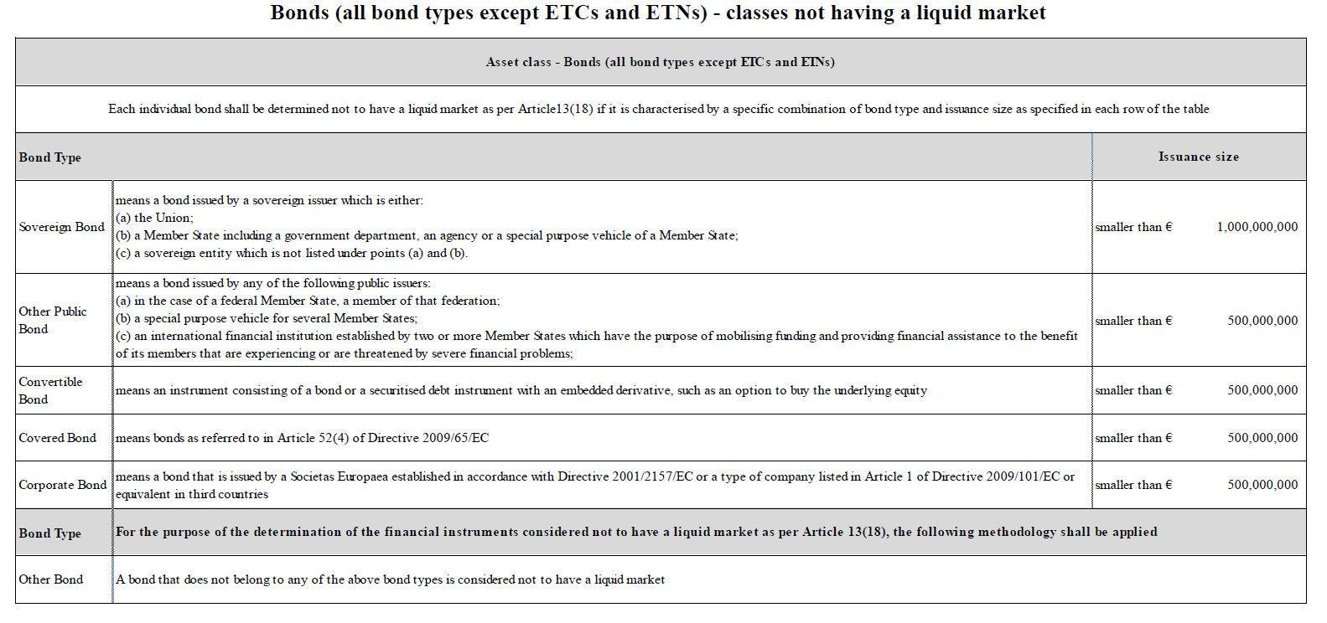
MiFID II/R sets out a definition for ‘liquid’ securities, including bonds:
Initial static liquidity assessment (COFIA) – new bonds
The initial static COFIA approach for new bonds is based purely on issuance size relative to the class of instrument.
This COFIA approach will be applied for up to 5.5 months following issuance.

Slide 20
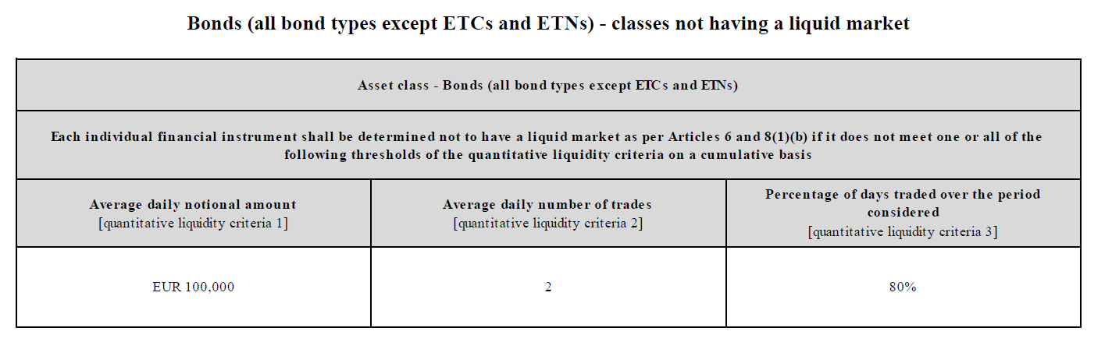
MiFID II/R sets out a definition for ‘liquid’ securities, including bonds:
Subsequent dynamic liquidity assessment (IBIA) – ‘seasoned’ bonds
Following a full quarter of trading data for an individual bond, the liquidity determination will be based on a periodic (quarterly) quantitative assessment
The key quantitative determinants for each individual bond are: (i) average daily notional amount traded; (ii) average daily number of trades; (iii) and the percentage of days traded over the assessment period.
(Subject to change)

Slide 21
MiFID II/R sets out a definition for Transparency:
Draft waivers and deferrals
Large in scale (LIS)
Pre-trade: for RMs, MTFs, OTFs, and SIs
An order is considered large in scale compared with standard market size if its equal to or larger than a determination of standard market size for the class of instrument. The threshold is calculated based on a percentile threshold of the distribution of trade sizes for the class of instrument.
Post-trade: for RMs, MTFs, OTFs, SIs, and other investment firms
A transaction is considered large in scale compared with standard market size if its equal to or larger than a determination of standard market size for the class of instrument. The threshold is calculated based on a percentile threshold of the distribution of trade sizes for the class of instrument.
RTS 2: Articles 9 & 13

Slide 22
MiFID II/R sets out a definition for Transparency:
Waivers and deferrals
Size specific to the instrument (SSTI)
Pre-trade: RMs, MTFs, OTFs, and SIs (for RFQ and voice trading systems)
An actionable IOI is considered above the size specific to the financial instrument if its equal to or larger than a determination of the minimum size of an actionable IOI for the class of instrument. The threshold is calculated based on a percentile threshold of the distribution of trade sizes for the class of instrument.
Post-trade: RMs, MTFs, OTFs, SIs, and other investment firms
A transaction is considered above the size specific to the financial instrument if its equal to or larger than a determination of the minimum size of transaction for the class of instrument. The threshold is calculated based on a percentile threshold of the distribution of trade sizes for the class of instrument.

Slide 23
MiFID II/R sets out a definition for Transparency:
Systematic Internalisers - Frequent, Systematic & substantial tests:
MiFID II/R extends the SI regime (traditionally found in equities) to a broader range of financial instruments, including bonds.
It applies to an investment firm which, on an organised, frequent and systematic, and substantial basis, deals on its own account by executing client orders outside a RM, MTF, or OTF.
Frequent and systematic test
For liquid bonds, this is where the number of trades during the last six months is equal to or larger than 2.5% of the total number of transactions in the relevant financial instruments in the EU executed on any venue or OTC during the same period. At a minimum, the firm should deal on its own account in the instrument once a week.
For illiquid bonds, this is where the firm has dealt on its own account OTC in the financial instrument on average once a week during the last six months.
Substantial test
The firm internalises on a substantial basis if the size of OTC trading on own account during the last six months is equal to or larger than:
  25% of the total nominal amount traded in that financial instrument executed by the investment firm on its own account or on behalf of clients, and carried out on any trading venue or OTC; or
  1% of the total nominal amount traded in that financial instrument executed in the EU and carried out on any EU trading venue or OTC.
(subject to change)

Slide 24
MiFID II/R sets out a definition for Transparency:
Systematic Internalisers – Determination, Requirements & Discretion:
Determination:
For new instruments, the assessments shall only be considered once the data covers a minimum period of six weeks.
MiFID II/R allows firms to choose to opt-in to be a systematic internaliser for a financial instrument, even where it does not meet all or any of the quantitative criteria, provided it complies with the requirements for SIs.
Requirements:
The investment firm will be identified in the case of an SI quote, whereas on a venue quotes will be averaged across all quoting firms and anonymized.
In the case of liquid bonds, SIs must make public firm quotes to all their clients when (a) they are requested for a quote by a client, or (b) they agree to provide a quote.
In the case of illiquid bonds, SIs must disclose firm quotes to their clients on request only where they agree to provide a quote.
Discretion:
SIs may update their quotes at any time, and may also withdraw quotes under exceptional circumstances.
Notwithstanding, SIs are allowed to decide which clients have access to, and can execute on, their quotes, on the basis of their commercial policy and in an objective, non-discriminatory way (thus SIs retain control over their trading activity).
Notes:
* There is a suggestion that this has been changed in the draft delegated acts to be applied on a class of instrument basis; i.e. if a firm qualifies as an SI in a particular instrument, it will be classified as an SI for all instruments in that entire class of instrument.

Slide 25
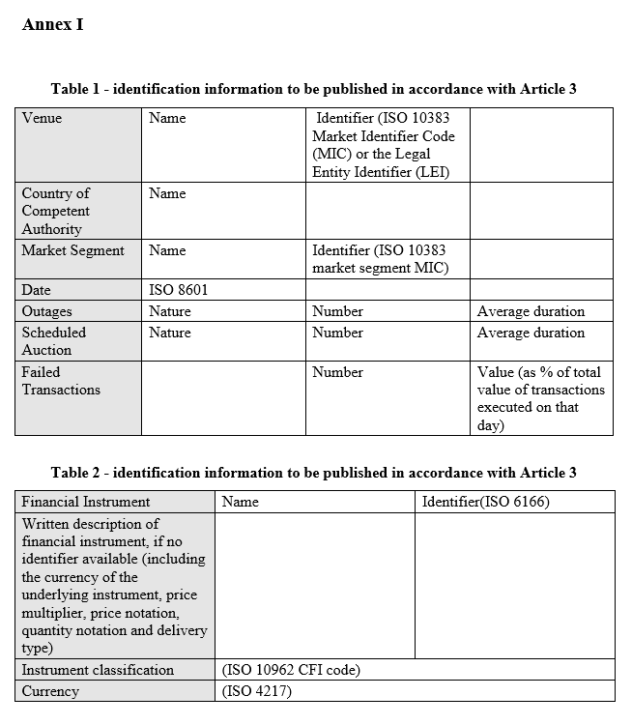
Annex I - Best Execution – reporting criteria

Slide 26
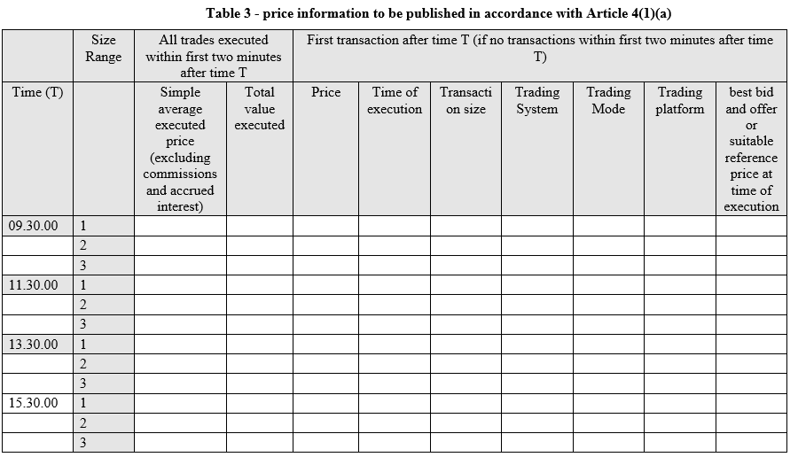
Annex I - Best Execution – reporting criteria

Slide 27
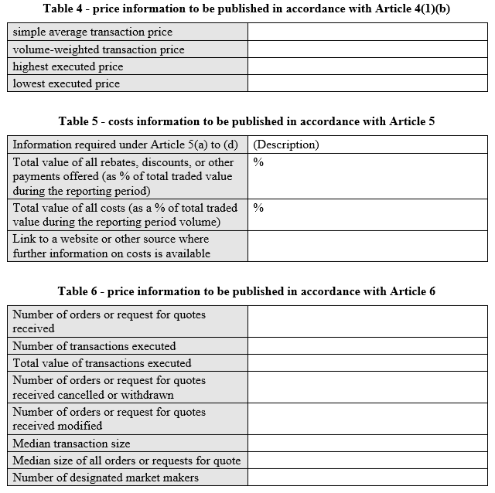
Annex I - Best Execution – reporting criteria

Slide 28
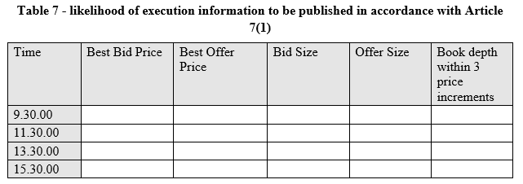
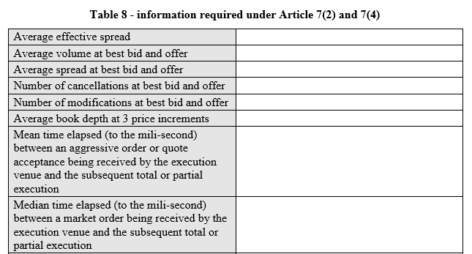
Annex I - Best Execution – reporting criteria

Slide 29
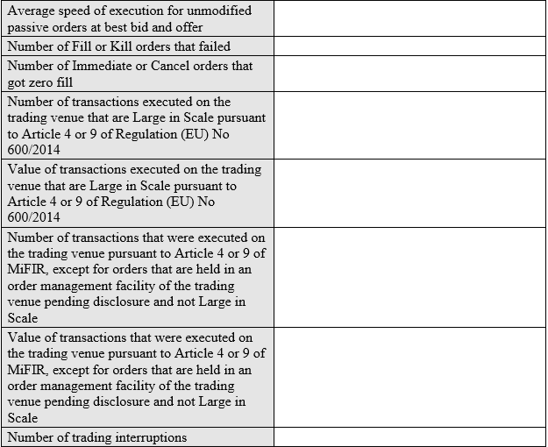
Annex I - Best Execution – reporting criteria

Slide 30
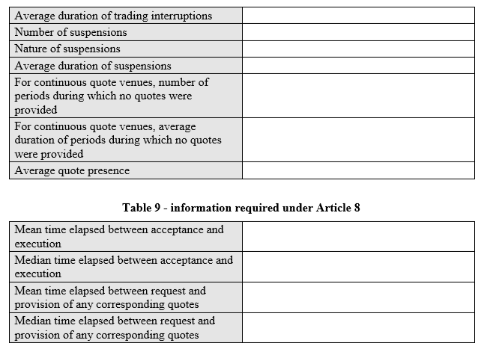
Annex I - Best Execution – reporting criteria

Slide 31
Evidencing best execution and top 5 venues
Annex II - Draft transparency requirements:
best execution – quality of execution – Top 5 venues
Description of any close links, conflicts of interests, and common ownerships with respect to any execution venues used to execute orders.
Description of any specific arrangements with any execution venues regarding payments made or received, discounts, rebates or non-monitory benefits received.
Explanation of how investment firms have used output from a consolidated tape provider to develop enhanced measures of execution quality or optimise and assess execution performances.
Explanation of the factors that led to a change in the list of execution venues listed in the firm’s execution policy, if such a change occurred.
Explanation of a change of client categorisation and how that affected execution arrangements.
Explanation of other criteria taking precedence over immediate price and cost when executing retail client orders and how best possible result to client was achieved.
Explanation of how investment firms make use of data and tools, on execution quality available from execution venues.
Explanation of the relative importance of the following execution factors: Price, costs, speed, likelihood of execution or any other consideration - including qualitative factors.

Slide 32
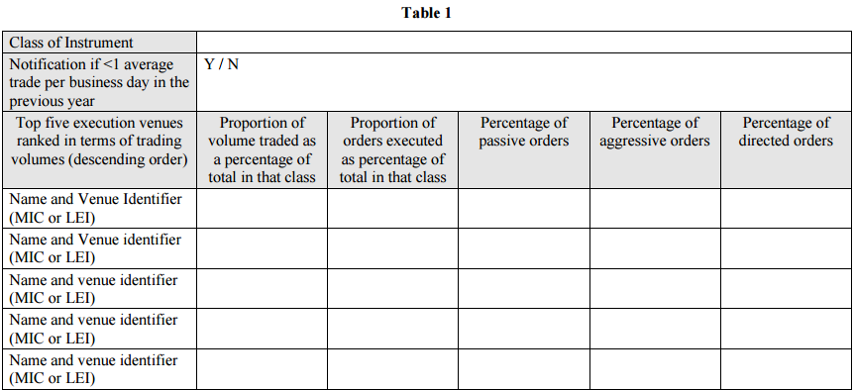
Annex II - Draft transparency requirements:
best execution – quality of execution – Top 5 venues

Slide 33
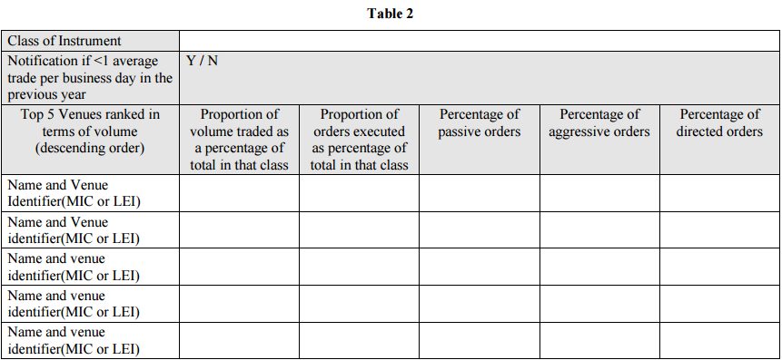
Annex II - Draft transparency requirements:
best execution – quality of execution – Top 5 venues

Slide 34
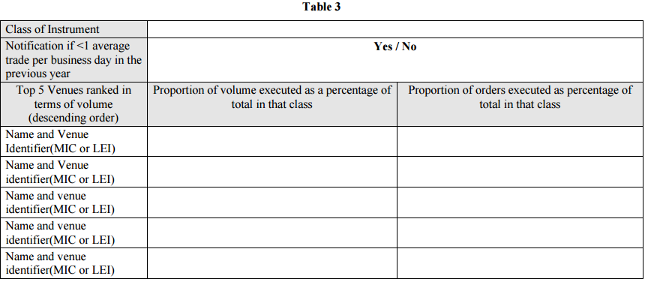
Annex II - Draft transparency requirements:
best execution – quality of execution – Top 5 venues

